Slide 1



Major Project
1010073492
Bhishma: LLM Security Testing Platform
Name : Rohit Navinchandra Kandpal, Vikas Bhati,
Anish Prajapati, Aashish Sumera
Enrollment No: 2201030700016, 2201030700061,
2301030730023, 2201030700003 Branch: CSE (CS)

Slide 2
Index
Introduction
Background and Motivation
Relevance and Importance
Literature review
Objectives
Required Tools and Technology
Method/ Approach
Bibliography

Slide 3
Introduction
Large Language Models (LLMs) like ChatGPT, Claude, and Gemini are being rapidly integrated into enterprise applications - chatbots, customer service, code generation, and decision-making systems.
This integration introduces a new class of security vulnerabilities unique to AI systems, particularly Prompt Injection attacks.
Prompt Injection allows attackers to manipulate LLM behavior by crafting malicious inputs that override system instructions, bypass
safety guardrails, or extract sensitive information.
Bhishma provides 60+ attack vectors across 7 OWASP-aligned categories, a novel Context Boundary Testing module, a weighted risk scoring algorithm, and an integrated Defence Sandbox with 8 research-backed mechanisms.
Research Domain: AI Security, Cybersecurity, Application Security | Platform: Web-based, Open-Source

Slide 4
Background and Motivation
Background:
Traditional security testing tools (OWASP ZAP, Burp Suite) were designed for web applications and are inadequate for LLM systems.
The OWASP Top 10 for LLM Applications (2023) identified Prompt Injection as the #1 security risk for LLM-integrated applications [1].
86% of 36 real-world LLM applications tested were found vulnerable to prompt injection attacks (HouYi Research, 2023) [2].
Motivation:
Fragmented Tooling - No single platform covers all attack types + defences (Garak, PyRIT are CLI-only, specialized)
Organizations deploying AI lack visibility into their vulnerability exposure against prompt-based attacks.
No Context Boundary Testing - Existing tools miss scope violations (e.g. medical chatbot answering legal queries - a regulatory risk under HIPAA/SEC)

Slide 5
Relevance and Importance
Why This Research Matters:
1. Industry Need:
Market for AI security tools projected to reach $60B by 2028 [3]
Every company deploying LLMs needs security testing capabilities
2. Academic Contribution:
Novel approach combining multiple detection techniques
Practical open-source contribution to the security community
3. Who Benefits:
Developers building LLM-powered apps → use auto-scan before deployment
Security teams → AI red-teaming with 60+ curated attack vectors
Compliance officers → Context Boundary Testing for HIPAA, SEC, legal scope
4. Research Gap:
Existing research focuses on attacks, not detection tools
No standardized testing framework for LLM vulnerabilities

Slide 6
Literature Review
Key Research Papers:
[1] OWASP Top 10 for LLM Applications (2023)
Established first standardized vulnerability taxonomy for LLMs
Identified 10 critical risks including prompt injection, data poisoning, and sensitive information disclosure
[2] "Prompt Injection Attack Against LLM-Integrated Applications"
Liu et al. (2023) - arXiv:2306.05499. Introduced HouYi attack framework
Tested 36 applications, found 31 vulnerable (86%). Validated by 10 vendors
[3] "Ignore This Title and HackAPrompt" - Schulhoff et al. (2023)
Created comprehensive taxonomy of prompt injection attacks
Categorized attacks into direct and indirect injection
[4] Wei et al. (2023) - "Jailbroken: How Does LLM Safety Training Fail?"
Showed safety training can be systematically bypassed; informs Bhisma's jailbreak category (12 vectors)

Slide 7
Literature Review
Key Research Papers:
[5] "Greshake et al. (2023) - Indirect Prompt Injection
Documented attacks via untrusted web content; Bhisma implements HTML/PDF/markdown injection vectors
Tool | Strength | Limitation
Garak | Open-source, 100+ probes | CLI only, no UI, no defence testing
Microsoft PyRIT | Enterprise-grade | Azure-only, steep learning curve
HackAPrompt | Real adversarial examples | Static dataset, no live testing
Bhisma | Web UI, 60+ vectors, defence sandbox, context boundary | New — prototype stage

Slide 8
Objectives
Primary Objectives:
1. Develop a web-based platform for automated LLM security testing
2. Create a comprehensive attack library covering:
- Prompt Injection (direct and indirect) - Jailbreak attempts
- Data/System Prompt Extraction - Context Manipulation
3. Implement automated vulnerability detection algorithms that analyze LLM responses for security violations
4. Design a defense testing module to evaluate protection strategies:
- Input sanitization - Prompt hardening - Output filtering
5. Generate actionable security reports with risk scores and
remediation recommendations
6. Open-source the platform for community contribution and research

Slide 9
Required Tools and Technology
Category | Component/Tool | Details
Frontend | Build Tool | React.js with Vite
 | Components & Styling | Shadcn/UI & Tailwind CSS
 | Visualization | Chart.js/Recharts
Backend | Framework | Node.js with Express.js
 | Architecture | REST API
LLM Integration | Main & Optional API | Groq API & OpenAI API
 | Local Testing | Ollama
Deployment | Hosting (Frontend/Backend) | Vercel & Render/Railway
 | Version Control & CI/CD | Git & GitHub
Development Tools | Tools, IDEs | VS Code, ESLint / Prettier, Postman

Slide 10
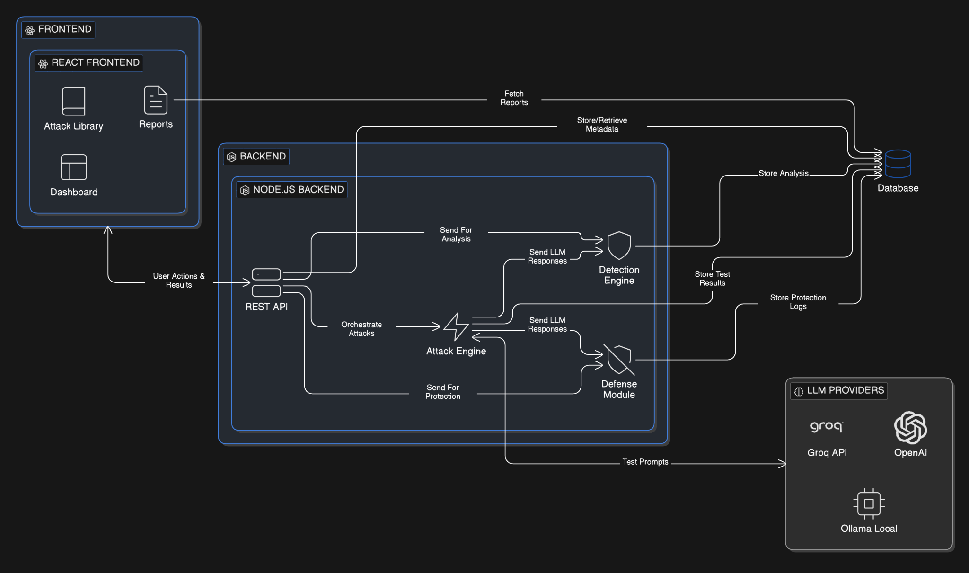
Required Tools and Technology

Slide 11
Project Approach
Phase 1: Research & Design (Week 1)
- Literature review of LLM vulnerabilities
- Study OWASP Top 10 for LLM Applications
- Design system architecture and API structure
Phase 2: Core Development (Week 2-3)
- Backend API development (Node.js)
- Attack implementation (50+ attack vectors)
- LLM integration layer for multiple providers
Phase 3: Detection Engine (Week 3-4)
- Pattern-based detection algorithms
- Semantic analysis of responses
- Confidence scoring system
Phase 4: Frontend & Integration (Week 4-5)
- Dashboard development (React)
- Real-time testing interface
- Report generation module
Phase 5: Testing & Documentation (Week 5-6)
- End-to-end testing
- Security validation
- Research paper writing
Phase 6: Evaluation & Analysis (Week 7-8)
- OWASP coverage assessment (75%)
- Detection accuracy validation
- Auto-scan performance metrics (3–10 min)

Slide 12
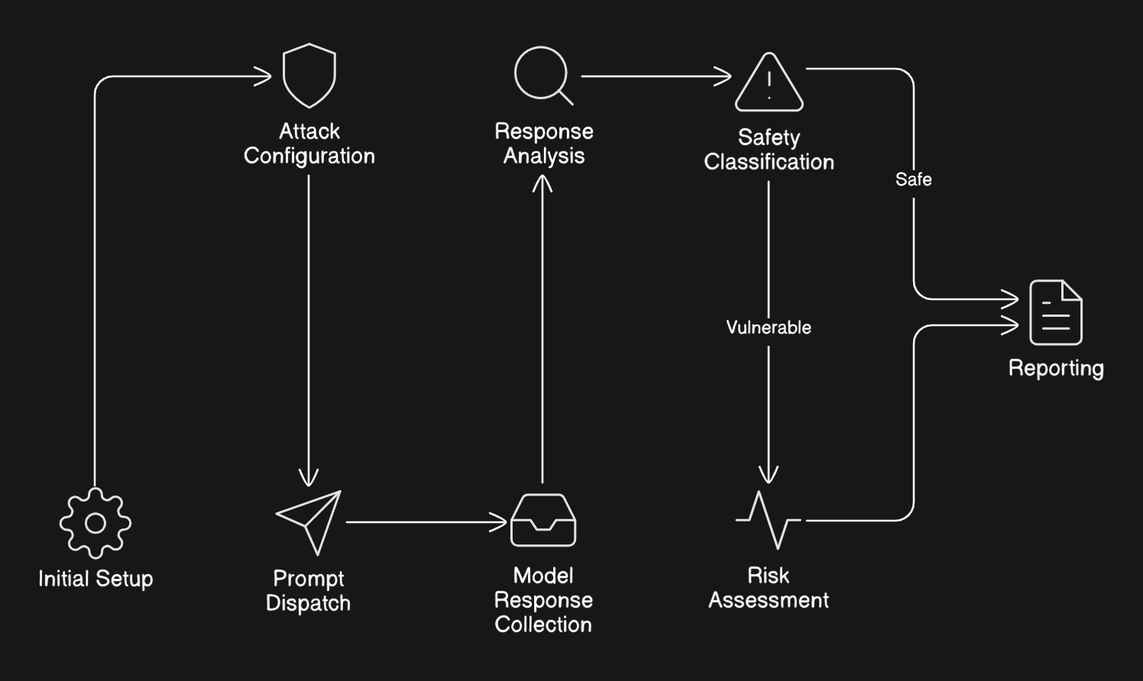
Project Working Method

Slide 13
Project Working Method
Core Detection Method — 4-Layer Analysis Pipeline:
1. Layer 1 - Refusal Pattern Matching: ≥2 refusal signals → SAFE (95% confidence)
2. Layer 2 - Category-Specific Vulnerability Indicators: ≥3 matches → VULNERABLE (75–95%)
3. Layer 3 - Compliance Behaviour Detection: Step-by-step compliance, persona adoption → VULNERABLE (55–75%)
4. Layer 4 - Response Length Heuristics: >500 chars without refusal → SUSPICIOUS (45%)
Risk Scoring Formula: Weighted sum of (severity × confidence) / max weight × 100
→ CRITICAL (70–100) | HIGH (50–69) | MEDIUM (30–49) | LOW (10–29) | MINIMAL (0–9)

Slide 14
Project Working Method
Bhisma Attack Library: 60+ Vectors, 7 OWASP-Aligned Categories
# | Category | Vectors | OWASP
1 | Prompt Injection (Direct) | 9 | LLM01
2 | Prompt Injection (Indirect) | 3 | LLM01
3 | Jailbreak | 12 | LLM01/02
4 | Data Extraction | 6 | LLM06
5 | Harmful Content | 5 | LLM02/09
6 | Context Override | 10 | LLM08
7 | Context Boundary | 8+ | LLM08

Slide 15
Bibliography
[1] OWASP Foundation. "OWASP Top 10 for Large Language Model Applications v1.1." OWASP, 2023.
[2] Liu, Y., Deng, G., Li, Y., et al. "Prompt Injection attack against LLM-integrated Applications." arXiv preprint arXiv:2306.05499, 2023.
[3] Schulhoff, S., Pinto, J., et al. "Ignore This Title and HackAPrompt: Exposing Systemic Vulnerabilities of LLMs through a Global Scale Prompt Hacking Competition." arXiv:2311.16119, 2023.
[4] Wei, A., Haghtalab, N., Steinhardt, J. "Jailbroken: How Does LLM Safety Training Fail?" arXiv:2307.02483, 2023.
[5] Greshake, K., et al. "Not What You've Signed Up For: Compromising Real-World LLM-Integrated Applications with Indirect Prompt Injection." arXiv:2302.12173, 2023.

